Slide 1
Performance Comparison of different molecular data in the identification of DIABETIC RETINOPATHY
EC6070 – COMPUTER ENGINEERING RESEARCH PROJECT
Supervisor
Dr. Pratheeba J.
By
2019/E/011 : Miss. Ashfa A.G.F.
2019/E/023 : Mr. Chandrasiri H.V.B.L.
01
Notes:
pratheeba Jeyananthan

Slide 2
INTRODUCTION
Diabetic retinopathy is a severe eye disease that can lead to blindness. Early detection and treatment of diabetic retinopathy can help to prevent blindness.
Currently, the diagnosis of DR primarily relies on clinical evaluation and imaging techniques, such as fundus photography or optical coherence tomography.
In here, we are using various molecular data, including DNA, RNA, and protein, to develop a model that can accurately predict the presence of diabetic retinopathy using Machine Learning.
02

Slide 3
LITERATURE REVIEW
03

Slide 4

[1] Y. Sun, H. Zou, X. Li, S. Xu, and C. Liu, “Plasma metabolomics reveals metabolic profiling for diabetic retinopathy and disease progression,” Frontiers, 29-Sep-2021.
This study aimed to investigate the difference in plasma metabolic profiles in patients with DR to better understand the disease's mechanism and disease progression.
The paper describes the metabolic changes that occur in the blood of diabetic retinopathy patients, which can be used to develop new molecular biomarkers for disease diagnosis and progression.
A risk score was established and evaluated using the least absolute shrinkage and selection operator regularization logistic regression (LASSO-LR) based machine learning method. This score was strongly associated with the occurrence of DR, indicating its predictive value.
04

Slide 5
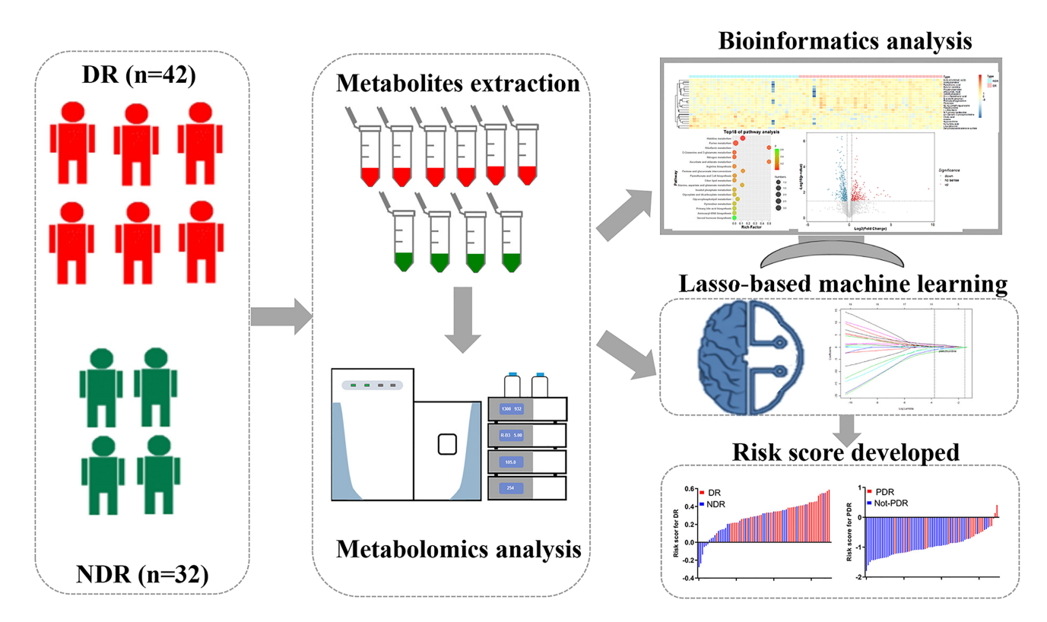
05
Notes:
plasma were extracted from blood samples of individuals with diabetic retinopathy
plasma were subjected to identify and quantify the metabolites present in the samples.
Bioinformatics analysis involves the use of computational tools and algorithms to analyze large-scale biological data
The risk score is a quantitative measure that combines the information from multiple selected metabolites to provide an estimate of an individual's risk

Slide 6
[2] Z.-W. Yu et al., “High Serum Neuron-Specific Enolase Level Is Associated with Mild Cognitive Impairment in Patients with Diabetic Retinopathy&lt;/p&gt;,” Diabetes, Metabolic Syndrome and Obesity: Targets and Therapy, pp. 1359–1365, Apr. 2020, doi: 10.2147/dmso.s249126.
The article discussed how diabetic retinopathy (DR) can increase the risk of mild cognitive impairment (MCI), confirmed by previous research.
This cross-sectional study included 124 patients, and patients’ demographic and clinical data were collected through questionnaires.
Serum neuron-specific enolase (NSE) levels were measured using electrochemiluminescence immunoassay.
06
Notes:
Neuron-Specific Enolase (NSE) is an enzyme that is primarily found in neurons and neuroendocrine cells.
Mild Cognitive Impairment (MCI) is considered as a clinical syndrome
decline in cognitive abilities, such as memory, thinking, and language skills.
high level of Neuron-Specific Enolase (NSE) in the blood serum is associated with an increased risk of developing Mild Cognitive Impairment (MCI) in patients with Diabetic Retinopathy (DR). Furthermore, it suggests that serum NSE could potentially serve as a biomarker to identify DR patients who have MCI.

Slide 7
[3] M. Bader Alazzam, F. Alassery, and A. Almulihi, “Identification of diabetic retinopathy through machine learning,” Mobile Information Systems, 26-Nov-2021.
A cross-sectional study of patients with suspected diabetic retinopathy (DR) who had an ophthalmological examination and a retinal scan is the focus of this research.
Specialized retinal images were analyzed and classified using OPF (Optimal Power Flow) and RBM (restricted Boltzmann machines) models.
The RBM model of machine learning automatic disease detection performed well in diabetic retinopathy screening.(89.47 ± 2.64)
07
Notes:
Classification – Unsupervised
Limitations: Number of Retina image lower

Slide 8
[4] Das, D., Biswas, S.K. and Bandyopadhyay, S., “A critical review on the diagnosis of diabetic retinopathy using machine learning and deep learning”, Multimedia Tools and Applications, vol.81 (18), no., pp.25613-25655, 2022. Available: 10.1007/s11042-022-12642-4.
This paper provides a critical review on the diagnosis of diabetic retinopathy using machine learning and deep learning techniques.
The aim of this research is to review and analyze the current state-of-the-art methods for diagnosing diabetic retinopathy using machine learning and deep learning.
The limitations of existing approaches in the diagnosis of diabetic retinopathy using machine learning and deep learning are discussed.
08
Notes:
Litrearature review: A critical review on diagnosis of diabetic retinopathy
using machine learning and deep learning
This paper is published on 2022. This paper is critical review on diagnosis of DR using ML and DL techniques.
this paper aim is to review and analyze the current state of the art methods for diagnosis DR using ML & DL.
Limitation of this research is existing approaches using ML & DL are discussed.

Slide 9
[5] Kamble, Vaibhav V., and Rajendra D., “Automated diabetic retinopathy detection using radial basis function”, Procedia Computer Science, vol.167, no. , pp. 799-808, 2020. Available: 10.1016/j.procs.2020.03.429.
The goal of the paper is to automatically detect retinal images as Non-DR (Non-Diabetic Retinopathy) or DR (Diabetic Retinopathy) based on a radial basis function (RBF) neural network classifier.
The experiment was performed on 130 DIARETDB0 & 89 DIARETDB1 retinal images database using an RBF neural network.
The study aims to save ophthalmologists' time and provide affordable early detection of diabetic retinopathy for the growing number of diabetic patients.
09
Notes:
Literature review: Automated diabetic retinopathy detection using radial basis function
Move to next research paper is "-----
this paper is published on 2020.
this research paper goal is to automatically detect retinal images as Non_DR or DR based on a RBFNN classifier.
Here, they used to two database DIARETDB0 & DIARETDB1, these are standard DR Databases.
This research aim to save ophthalmologists' time and provide affortable earl detection---------
page10
The proposed system achieved the 0.943 Sensitivity, 0.16 Specificity and 0.894 accuracy for DIARETDB1 and
0.830 Sensitivity, 0.043 Specificity & 0.712 accuracy for DIARETDB0 shown in table.

Slide 10
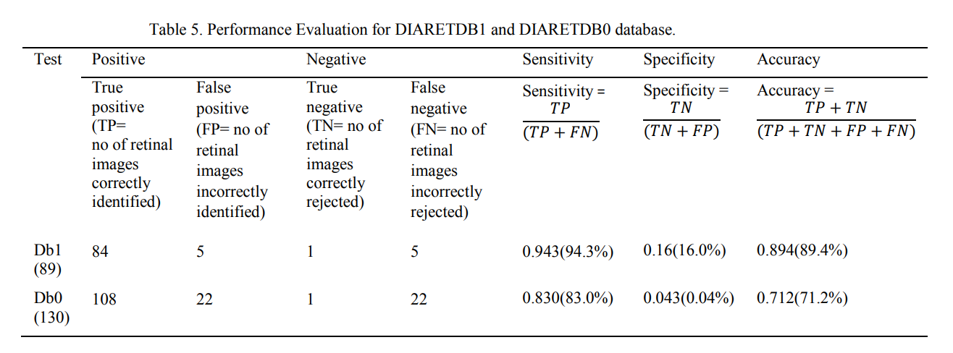
10

Slide 11
More Papers…
[6] Gupta, S., Thakur, S. and Gupta, A., “Optimized hybrid machine learning approach for smartphone based diabetic retinopathy detection”, Multimedia Tools and Applications, vol.81 (10), pp.14475-14501, 2022. Available: 10.1007/s11042-022-12103-y.
[7] G. L. D’Adamo, J. T. Widdop, and E. M. Giles, “The future is now? clinical and translational aspects of ‘OMICS’ technologies,” Immunology & Cell Biology, vol. 99, no. 2, pp. 168–176, 2020.
[8] L. Adlung, Y. Cohen, U. Mor, and E. Elinav, “Machine learning in clinical decision making,” Med, vol. 2, no. 6, pp. 642–665, Jun. 2021, doi: .
11

Slide 12
More Papers…
[9] Nomura, A., Noguchi, M., Kometani, M., Furukawa, K. and Yoneda, T., “Artificial intelligence in current diabetes management and prediction”, Current Diabetes Reports, vol.21(12), pp.61, 2021. Available: 10.1007/s11892-021-01423-2.
[10] Miotto, R., Wang, F., Wang, S., Jiang, X., & Dudley, J. T., Deep learning for healthcare: review, opportunities and challenges, Briefings in bioinformatics, vol.19(6), pp.1236-1246, 2018. Available: 19/6/1236/3800524
12

Slide 13
Gap In The Literature
[5] Kamble, Vaibhav V., and Rajendra D., “Automated diabetic retinopathy detection using radial basis function”, Procedia Computer Science, vol.167, no. , pp. 799-808, 2020. Available: 10.1016/j.procs.2020.03.429.
As they using abnormal and excessive bleeding from blood vessels presence in retinal image there is a possibility that it caused by other factors rather than diabetic.
The performance of the system in detecting diabetic retinopathy may heavily rely on the quality and clarity of the retinal images used.
The research has several limitations, including a small sample size, a single type of neural network.
13
Notes:
Gap in the literature:
The research paper "Automted----" we selected for the research gap.
DR is a complication of diabetes. Current situation, they are used to retinal images for identify the diagnosis.--------
And, The retinal images are used in detecting DR may heavily rely on the quality and clarity for the performance.
Then, This research paper has several limitation, first thing here used a small sample size database, and a single type of neural network.

Slide 14
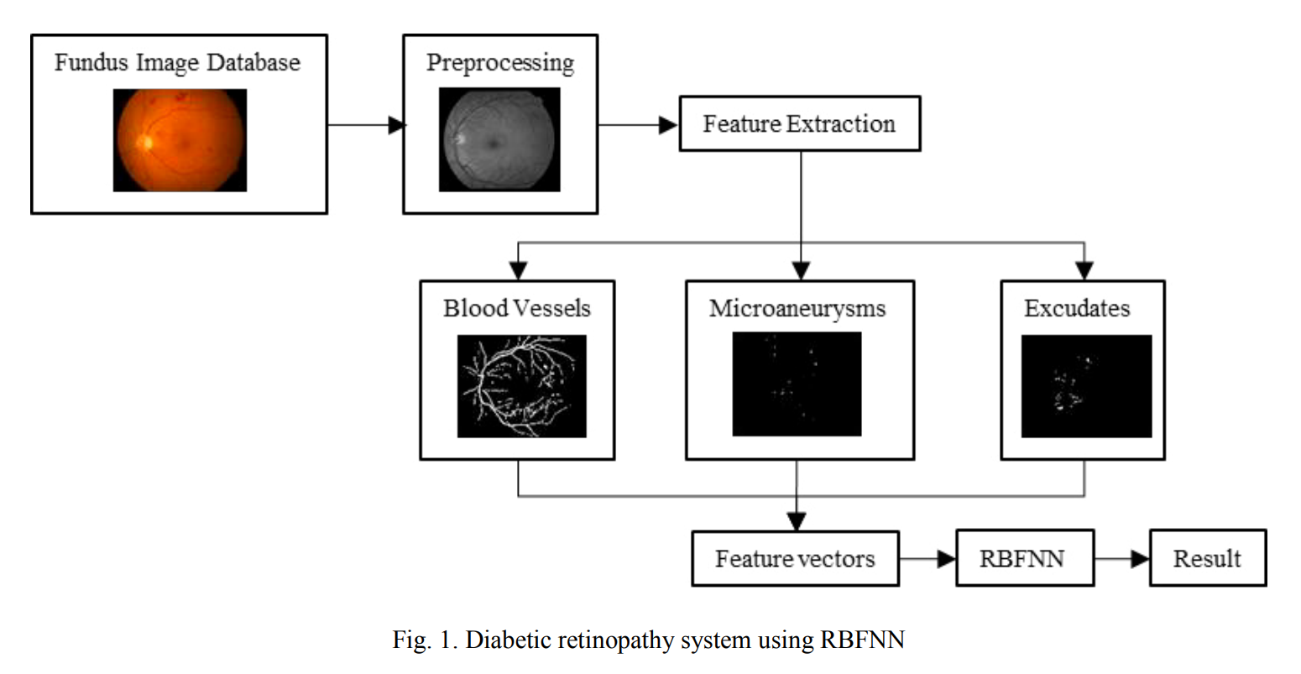
14

Slide 15
In Our Research,
There is a need for further research to evaluate and compare the effectiveness of molecular data types, explore their combined use with machine learning approaches, and investigate the potential synergistic effects or trade-offs.
We can extend this research to determine the stage of DR and enable personalized treatment strategies for diabetic retinopathy.
15

Slide 16
Data to be used in this work
Alterations of 5-Hydroxymethylcytosines in Circulating Cell-free DNA Reflect Retinopathy in Type 2 Diabetes
This contains genome-wide methylation profiles of circulating cell-free DNA (cfDNA) from 70 Chinese patients with type 2 diabetes mellitus (T2DM), including 35 patients with diabetic retinopathy (DR) and 35 age-, gender-, and diabetic duration-matched controls.
16
Notes:
"Alterations of 5-Hydroxymethylcytosines": This refers to changes or modifications that occur in a specific type of DNA base called cytosine.
"Circulating Cell-free DNA": DNA is the genetic material present in cells, but it can also be found outside of cells in various body fluids such as blood. Circulating cell-free DNA refers to fragments of DNA that are released into the bloodstream or other body fluids when cells die and break down. These fragments are not contained within intact cells.
"Retinopathy in Type 2 Diabetes": Retinopathy is a condition that affects the retina, the light-sensitive tissue at the back of the eye. It is a complication commonly associated with type 2 diabetes, which is a chronic metabolic disorder characterized by high blood sugar levels.

Slide 17
Data to be used in this work
In-depth transcriptomic analyses investigating molecular mechanisms underlying diabetic retinopathy
This is a collection of transcriptomic data from human post-mortem retinal samples. The data was collected from 80 patients diagnosed with various stages of diabetic retinopathy (DR). The data was analyzed using RNA-Seq, a high-throughput sequencing technique that can measure gene expression in a sample.
totalRNA
smallRNA
17
Notes:
It involves studying the transcriptome, which is the complete set of RNA molecules transcribed from the genes in a cell or tissue. In this context, "in-depth transcriptomic analyses" means conducting comprehensive and detailed investigations into gene expression patterns and changes in the context of diabetic retinopathy.
RNA sequencing, is a high-throughput sequencing technique used to analyze the transcriptome of a biological sample. It provides a comprehensive and quantitative measurement of RNA molecules present in a sample, allowing researchers to study gene expression and transcriptomic profiles.
Total RNA: Total RNA refers to the entirety of RNA molecules present in a biological sample, such as a tissue or cell. It includes all types of RNA, including messenger RNA (mRNA), ribosomal RNA (rRNA), and transfer RNA (tRNA), among others.
Small RNA: Small RNA refers to a specific class of short RNA molecules, typically ranging from 20 to 200 nucleotides in length. Small RNA molecules have diverse functions and play important roles in regulating gene expression and various cellular processes.

Slide 18
Plan of Our Work
Proposal Writing
Implementation Process
01
02
03
04
05
Review
Previous Articles
Dataset
Preparation
Analyse Results & Document Preparation
Literature Review
Annotated Bibiliography
Compare Accuracies for each subtype
18

Slide 19
Methodology
Dataset Preparation
Data Collection
Data Preprocess (Handling Missing Values, Normalizing, etc.)
Implementation Process
Feature Selection
Model Creation
Model Evaluation
Find Effectiveness
19

Slide 20
Timeline
ACTIVITY | SEMESTER 6 |  |  |  | SEMESTER 7 |  |  |  | SEMESTER 8
 | W 1 | W 3-11 | W 12-14 | W 15-16 | W 1 | W 2-4 | W 5-10 | W 10-16 | W 1-2 | W 2-4 | W 4-6 | W 6-8
Literature Review
Annotated Bibiliography
Research Proposal
Data Collection
Data Preparation
Build the Model
Experimenting the Model
Research Project Report Writing
Research Paper Writing
20

Slide 21
REFERENCES
[1] Y. Sun, H. Zou, X. Li, S. Xu, and C. Liu, “Plasma metabolomics reveals metabolic profiling for diabetic retinopathy and disease progression,” Frontiers, 29-Sep-2021.
[2] Z.-W. Yu et al., “&lt;p&gt;High Serum Neuron-Specific Enolase Level Is Associated with Mild Cognitive Impairment in Patients with Diabetic Retinopathy&lt;/p&gt;,” Diabetes, Metabolic Syndrome and Obesity: Targets and Therapy, pp. 1359–1365, Apr. 2020, doi: 10.2147/dmso.s249126.
[3] M. Bader Alazzam, F. Alassery, and A. Almulihi, “Identification of diabetic retinopathy through machine learning,” Mobile Information Systems, 26-Nov-2021.
21

Slide 22
REFERENCES
[4] Das, D., Biswas, S.K. and Bandyopadhyay, S., “A critical review on the diagnosis of diabetic retinopathy using machine learning and deep learning”, Multimedia Tools and Applications, vol.81 (18), no., pp.25613-25655, 2022. Available: 10.1007/s11042-022-12642-4.
[5] Kamble, Vaibhav V., and Rajendra D., “Automated diabetic retinopathy detection using radial basis function”, Procedia Computer Science, vol.167, no. , pp. 799-808, 2020. Available: 10.1016/j.procs.2020.03.429.
22

Slide 23
REFERENCES
[6] Gupta, S., Thakur, S. and Gupta, A., “Optimized hybrid machine learning approach for smartphone based diabetic retinopathy detection”, Multimedia Tools and Applications, vol.81 (10), pp.14475-14501, 2022.
[7] G. L. D’Adamo, J. T. Widdop, and E. M. Giles, “The future is now? clinical and translational aspects of ‘OMICS’ technologies,” Immunology & Cell Biology, vol. 99, no. 2, pp. 168–176, 2020.
[8] L. Adlung, Y. Cohen, U. Mor, and E. Elinav, “Machine learning in clinical decision making,” Med, vol. 2, no. 6, pp. 642–665, Jun. 2021, doi: .
23

Slide 24
REFERENCES
[9] Nomura, A., Noguchi, M., Kometani, M., Furukawa, K. and Yoneda, T., “Artificial intelligence in current diabetes management and prediction”, Current Diabetes Reports, vol.21(12), pp.61, 2021. Available: 10.1007/s11892-021-01423-2.
[10] Miotto, R., Wang, F., Wang, S., Jiang, X., & Dudley, J. T., Deep learning for healthcare: review, opportunities and challenges, Briefings in bioinformatics, vol.19(6), pp.1236-1246, 2018. Available: 19/6/1236/3800524
24

Slide 25
THANK YOU!
25

